Slide 1
Rules at work
02. Imperatives

Slide 2
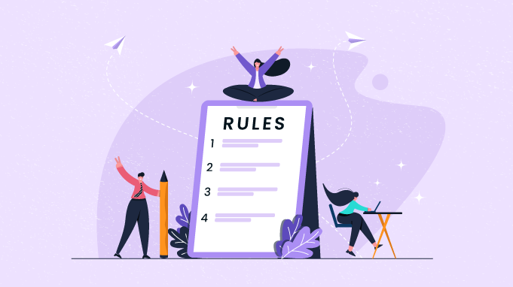
Rules at work
Be on time for work.
Make a list of your appointments.
Don’t be late for meetings.
Record all your interviews.
Pay attention to what your project manager tells you.
Don’t click on unknown links
Remember to turn off your computer at the end of the day.
Don’t use the photocopier.
Always be on time with your reports.
Take a one-hour lunch break.

Slide 3
Imperatives, use
Imperatives are also called orders or instructions. Imperatives are used to tell people what to do, give instructions and advice, as well as make recommendations, suggestions, and offers. For example:
Don’t forget to turn off your computer.
Take this folder to the meeting.
Imperatives don’t usually have a subject. It is understood that the subject is “you”. Sometimes we use a person’s name to show who the instruction is being given to. For example:
Come quickly, Ben! You’ll be late for the meeting.
We can also add the word please to make the request or instruction more polite. For example:
Kim, show me where the photocopier is, please.

Slide 4
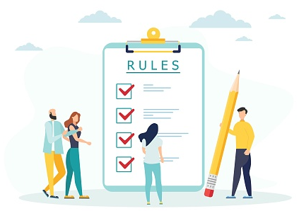
Imperatives, form
Positive = base form of the verb
Get some more paper for the photocopier.
Negative = do not / don’t + base form of the verb
Don’t miss your appointment.
Note: When we use verbs like forget, try, and remember in the imperative, they are usually followed by the infinitive (to + base form of the verb). For example:
Don’t try to use this photocopier. It’s not working.
Remember to listen carefully during the interview.

Slide 5
Imperatives, be
When the imperative is followed by an adjective, we use the word be as the imperative.
positive = be
Be quick! If we don’t work hard, we won’t finish the report.
negative = do not / don’t be
Don’t be late. The interview starts at 9.00 a.m.

Slide 6
Identify the imperatives
Be on time for work.
Make a list of your appointments.
Don’t be late for meetings.
Record all your interviews.
Pay attention to what your project manager tells you.
Don’t click on unknown links
Remember to turn off your computer at the end of the day.
Don’t use the photocopier.
Always be on time with your reports.
Take a one-hour lunch break.
Notes:
Be
Make
Dont be
Record
Pay
Dont click
Remember
Dont use
be
Take

Slide 7
Match the situation to the sentence
Situation | Imperative
1. You are showing Mark his new office. He doesn’t know where to put his folders. You say, … | a. “Have a seat, Mark!”
2. Mark doesn’t know how to log in. You say, … | b. “Ask the receptionist for some.”
3. Mark is coming into your office for a meeting with you. You say, … | c. “Don’t use the photocopier!”
4. The photocopier isn’t working, but Mark doesn’t know about it. You say, … | d. “Please give me the Antonio file.”
5. Mark needs some folders but doesn’t know where to get them. You say, … | e. “Don’t worry, Mark!”
6. Mark has an interview at 9:00 but at 8:58 he is still talking on the phone. You say, … | f. “Put your things on these shelves.”
7. Mark is interviewing someone for the first time. He is nervous about it. You say, … | g. “Don’t be late, Mark!”
8. Mark has a report that you need. You say, … | h. “Wait for me to explain what to do.”
Notes:
1. f
2. H
3. A
4. C
5. B
6. G
7. E
8. d

Slide 8
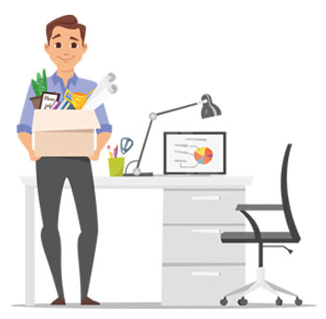
Advice for the new employee
Meet Mark, he is new at Hexaware.
What advice can you give him?
Example:
Don‘t forget to send reports on time.
Change your password every few weeks.

